Slide 1


Slide 2







Fahmida Shah
ID: 0242310005341460
Shahidul Islam Nayeem
ID: 0242310005341439
Shaikat Sharma
ID: 0242310005341443
Khadiza Begum
ID: 0242310005341276
Erin Jahan Eshita
ID: 0242310005341074
Suraiya Rahman Suzan
ID:02423100053410040

Slide 3
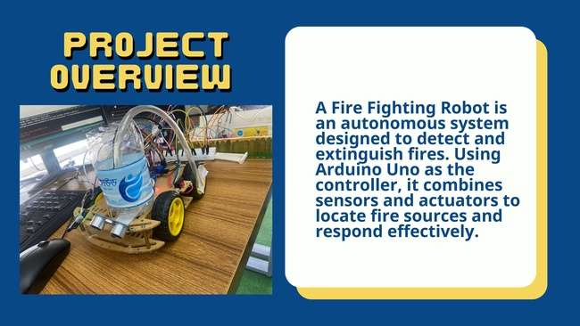
A Gas Detector and Fire Fighting Robot is an autonomous system that detects gas and extinguishes fires. Using Arduino Uno as the controller, it combines sensors and actuators to locate fire and gas sources and respond effectively.

Slide 4
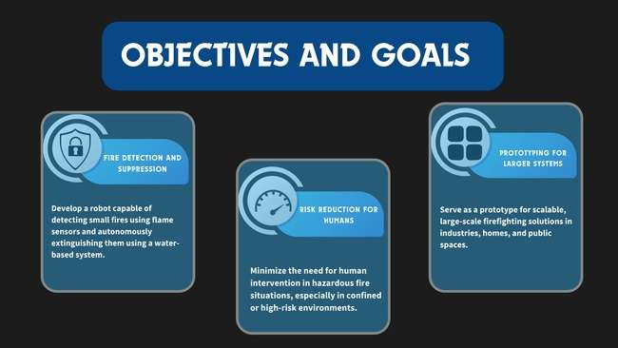
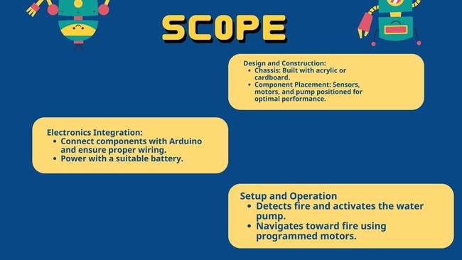

Slide 5
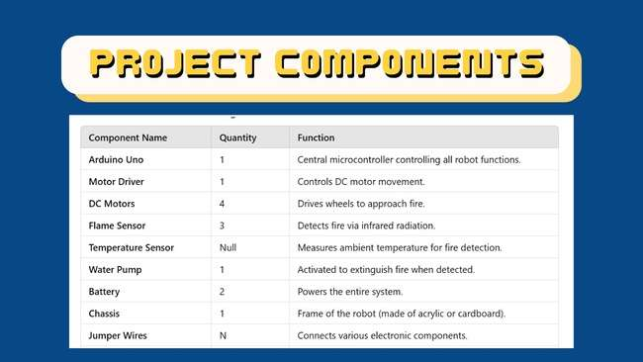

Slide 6
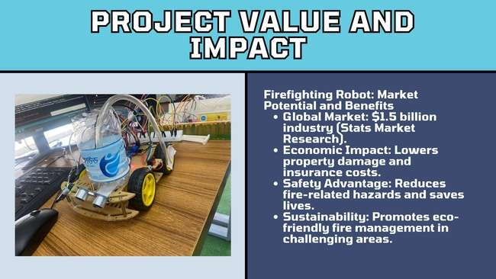

Slide 7
Gas Detector Robot: Market Potential & Benefits
Market Potential
Essential for industries like oil & gas, mining, and manufacturing.
AI, IoT, and robotics improve precision and autonomy.
Used in hazardous environments, agriculture, and environmental monitoring.
Growing adoption in emerging economies.
Key Benefits
Reduces human exposure to dangerous gases.
Lowers inspection and maintenance costs.
Real-time monitoring and access to hard-to-reach areas.
Prevents pollution through early detection.
Provides analytics for predictive maintenance.

Slide 8

1st Gas Detection 2nd Target and Approach 3rd alert by buzzer

Slide 9
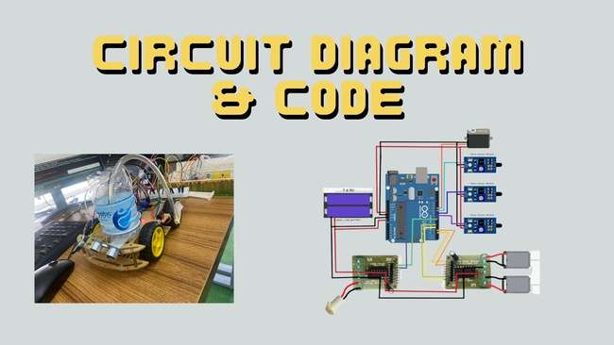

Slide 10
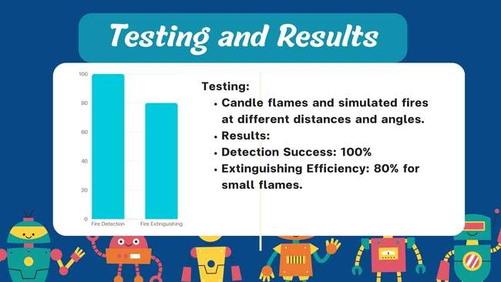

Slide 11
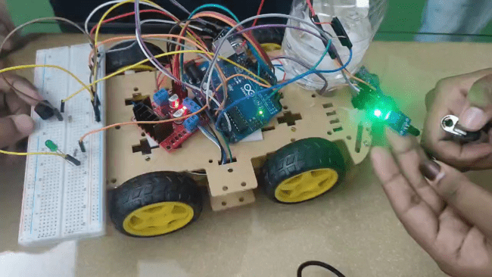
PROJECT VIDEO

Slide 12


